Slide 1
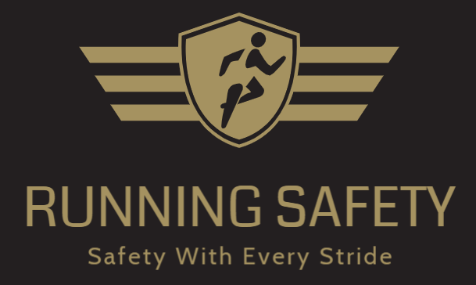
Running Safety
Safety with every Stride

Slide 2

Value Proposition
Who is this for?
Our product is design for night runner, especially women.
What does it provide?
The RunningSafety+ is a self-working device that provides it’s user safe running experience.
Advantage?
Unlike RunAngel, a bracelet that can send alert message by pressing the center button, RunningSafety+ can automatically detect danger and send out SOS messages without any action from the runner.

Slide 3
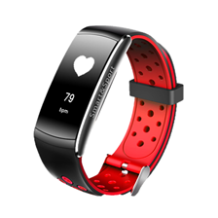
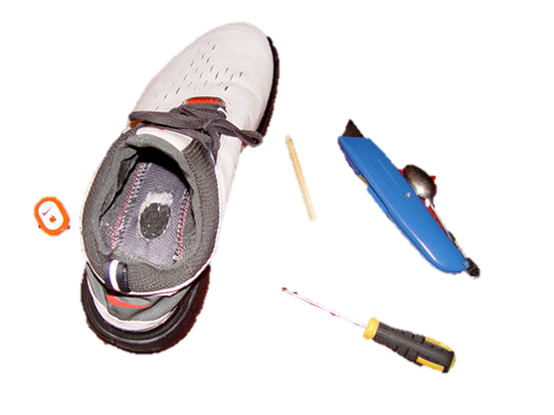
Visualization

Slide 4

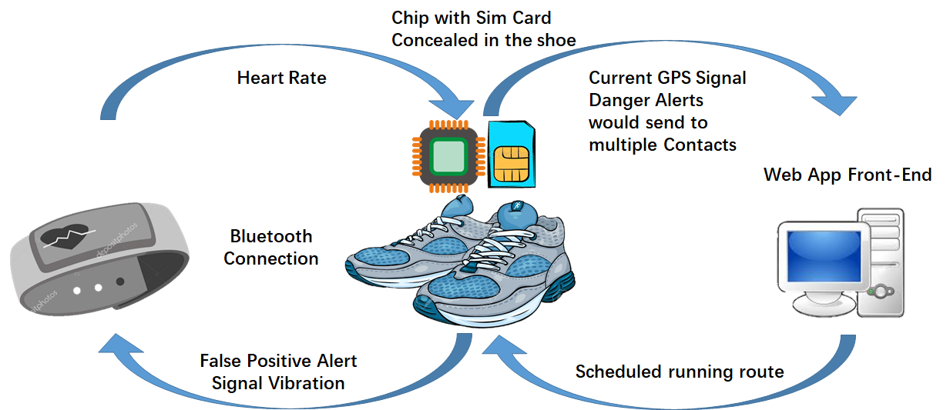
GPS

Slide 5
System
Hardware:
Software:
Heat rate detection
Interface for programmed emergency contact which can send message with GPS location.
Distress Sensors (Accelerometer, Pulse Monitor)
GPS
μC
Bluetooth
μC
Contained in bracelet
SMS
Contained in shoe
Notes:
What is the pattern of heart rate? How to define a “dangerous situation ”

Slide 6
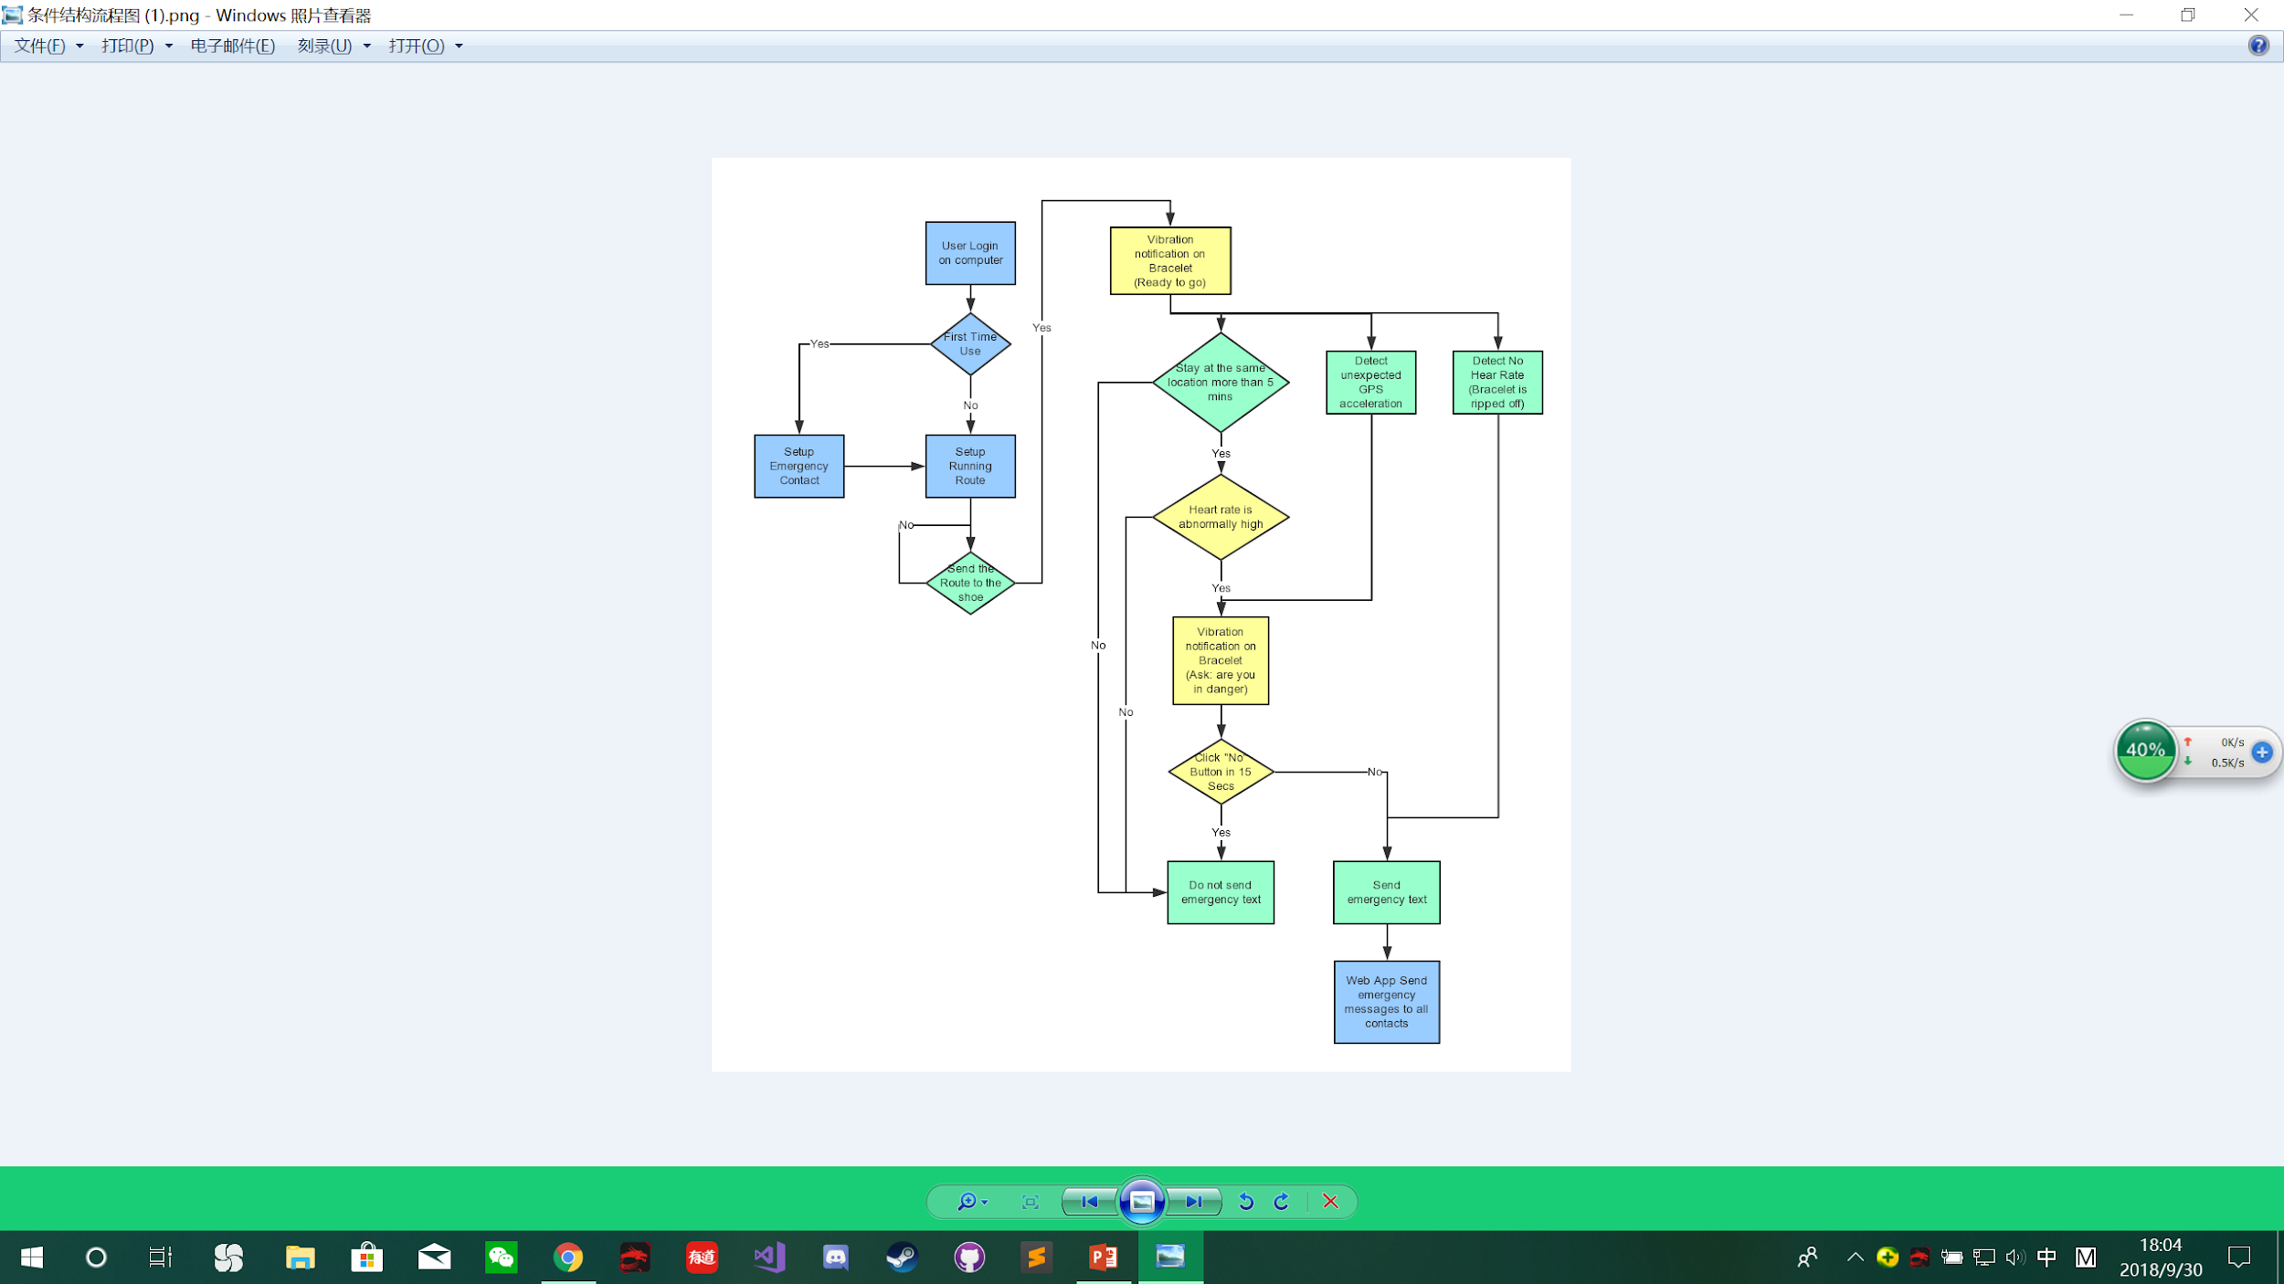
Green: In-shoe Device
Yellow: Bracelet
Blue: Web App Front-End

Slide 7
Running Safety Plus
A safety device that is comfortably concealed and fulfills all functions including track GPS coordinates, heart rate, the user’s pace, and contact an emergency contact.
With a rise in the amount of dangerous or health related emergencies that occur to young joggers, our device provides an efficient solution to help these cases.
What is Special about your product?
Completely concealed and difficult to detect
Requires no action from the user
No sounding alarm, but immediately contacts a programmed emergency contact
Technology Solution
Wristband and shoe insert with bluetooth communication
Web Application for user interface with device
Notes:
Note that sometimes you need more than one value proposition. For example if the beneficiary does not pay you, then you need one value proposition for your beneficiary and one for your paying customer.

Slide 8
Thank you

